Slide 1
CSCE 5200 Information Retrieval and Web Search
Chapter 1: Boolean retrieval

Slide 2
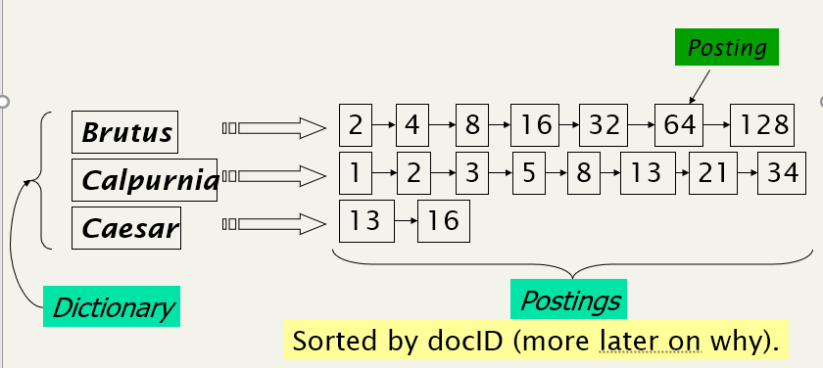
Inverted index
The two parts of an inverted index.
Each item in the list – records that a term appeared in a document (DocID is stored): conventionally called a posting.
The list: called a postings list (or inverted list)
All the postings lists taken together: referred
to as the postings.

Slide 3
The index we just built
How do we process a query using an inverted index?
Later - what kinds of queries can we process?

Slide 4
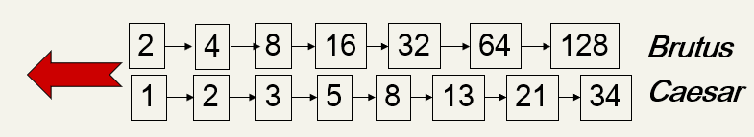
Query processing: AND
Consider processing the conjunctive query:
Brutus AND Caesar
1. Locate Brutus in the Dictionary;
Retrieve its postings.
2. Locate Caesar in the Dictionary;
Retrieve its postings.
“Merge” (Intersect) the two postings lists:

Slide 5
Query processing: AND (cont.)
The intersection operation
Need to efficiently intersect postings lists so as to be able to quickly find documents that contain both terms.
This operation: referred to as merging postings lists

Slide 6
The merge algorithm (1 of 3)
A simple and effective method of intersecting postings lists
Maintain pointers into both lists and walk through the two postings lists simultaneously, in time linear in the total number of postings entries
At each step, we compare the docID pointed to by both pointers. If they are the same, we put that docID in the results list, and advance both pointers. Otherwise we advance the pointer pointing to the smaller docID.

Slide 7
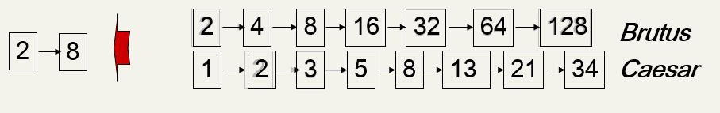
The merge algorithm (2 of 3)
If the list lengths are x and y, the merge takes O(x+y)
operations.
Crucial: postings sorted by docID.

Slide 8
The Merge Algorithm (3 of 3)
Fig. 1.6. Algorithm for the intersection of two postings lists P1 and P2. From “ Introduction to Information Retrieval”(C. Manning, P. Raghavan and H. Schütze,, 2008, pg.11).

Slide 9
Boolean queries: Exact match
The Boolean Retrieval model is being able to ask a query that is a Boolean expression:
Boolean Queries are queries using AND, OR and NOT to join query terms
Views each document as a set of words
Is precise: document matches condition or not.
Primary commercial retrieval tool for 3 decades.
Professional searchers (e.g., lawyers) still like Boolean queries:
You know exactly what you’re getting.

Slide 10
Boolean queries: More general merges
Exercise: Suppose N is the total number of documents in the collection, for the queries below, can we still run through the intersection in time O(x + y), where x and y are the lengths of the postings lists for Brutus and Caesar? If not, what can we achieve?
a. Brutus AND NOT Caesar
b. Brutus OR NOT Caesar

Slide 11
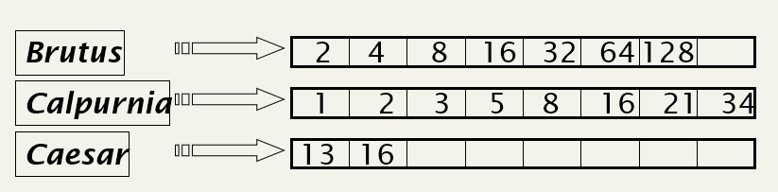
Query optimization
Query Optimization: the process of selecting how to organize the work of answering a query so that the least total amount of work needs to be done.
The order in which postings lists are accessed
Consider a query that is an AND of t terms.
For each of the t terms, get its postings, then AND them together.
Query: Brutus AND Calpurnia AND Caesar

Slide 12
Query optimization example
The standard heuristic
Process terms in order of increasing document freq:
Start by intersecting the two smallest postings lists, then all intermediate results must be no bigger than the smallest postings list, and we are therefore likely to do the least amount of total work.
Execute the query as (Caesar AND Brutus) AND Calpurnia.

Slide 13
Query optimization example cont.
This is a first justification for keeping the frequency of terms in the dictionary
Allows us to make this ordering decision based on in-memory data before accessing any postings list.

Slide 14
Algorithm for conjunctive queries
Fig. 1.7. Algorithm for conjunctive queries. From “ Introduction to Information Retrieval”(C. Manning, P. Raghavan and H. Schütze,, 2008, pg.12).

Slide 15
Optimization of more general queries
Evaluating(madding OR crowd) AND (ignoble OR strife) AND (killed OR Slain)
Get freq’s for all terms.
Estimate the size of each OR by the sum of the freq’s of its disjuncts.
Process the query in increasing order of the size of each disjunctive term.

Slide 16
Exercise
Get freq’s for all terms.
Estimate the size of each OR by the sum of the freq’s of its disjuncts.
Process the query in increasing order of the size of each disjunctive term.
Recommend a query processing order for
(tangerine OR trees) AND
(marmalade OR skies) AND
(kaleidoscope OR eyes)
given the following postings
list sizes:
Term | Postings size
eyes | 213312
kaleidoscope | 87009
marmalade | 107913
skies | 271658
tangerine | 46653
trees | 316812

Slide 17
Information Retrieval and Web Search
Chapter 2: The term vocabulary and postings lists

Slide 18
Recap of the previous lecture
Basic inverted indexes:
Structure: Dictionary and Postings
Key step in construction: Sorting
Boolean query processing
Simple optimization
Linear time merging

Slide 19
Recap of the previous lecture, cont.
The major steps in inverted index construction
Collect the documents to be indexed
Tokenize the text
Do linguistic preprocessing of tokens
Index the documents that each term occurs in

Slide 20
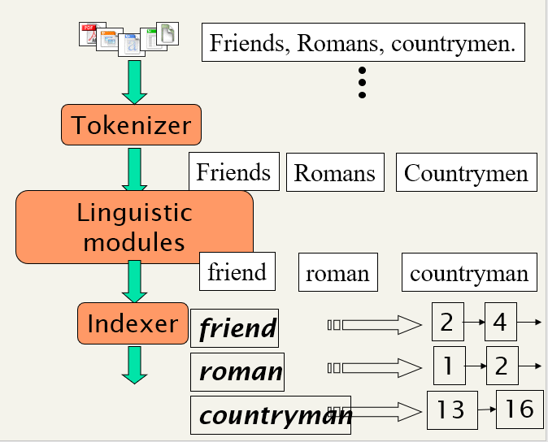
Inverted index construction
Collect Documents to
be indexed.
Tokenize the text, turning each document into a list of tokens
Token stream.
Normalized tokens:
indexed terms
Inverted index: consisting of
a dictionary and postings.

Slide 21
Plan for this chapter
Elaborate basic indexing
Preprocessing to form the term vocabulary
The basic unit of a document
Tokenization and linguistic preprocessing (determine the vocabulary of terms that a system uses)
The implementation of postings lists
Examine an extended postings list data structure that supports faster querying: skip lists
Building postings data structures suitable for handling phrase and proximity queries: positional postings .

Slide 22
Parsing a document
What format is it in?
pdf/word/excel/html?
What language is it in?
What character set is in use?
For the case of plain English text in ASCII encoding, this is trivial
Problems:
The sequence of characters may be encoded by one of various single-byte or multi-byte encoding schemes, such as Unicode UTF-8.
Determine the document format, such as Microsoft Word DOC files, zip files, XML/HTML files if the markup is going to be ignored.

Slide 23
Choosing a document unit
What is a document unit for indexing?
Each file in a folder as a document
Each email message as a document
An email with 5 attachments? With an attached zip file?
A group of files (PPT as HTML pages): combine multiple files into a single document
The issue of indexing granularity for very long documents
A collection of books: a bad idea to index an entire book as a document
Index each chapter or paragraph as a mini-document.

Slide 24
Tokens and Terms

Slide 25
Tokenization
The process of chopping character streams into tokens.
Input: “Friends, Romans and Countrymen”
Output: Tokens
Friends
Romans
Countrymen
Each such token is now a candidate for an index entry, after further processing
Described below

